Slide 1
Final Project
Group 4
Project Name : Image Restoration and Enhancement Using Generative AI Models
Team members – 1) Nitish Bhardwaj
2) Syed Ahmed Ali

Slide 2
Agenda
Problem Statement
System Architecture
3. Methodology (4 Tasks)
4. Experimental Setup
5. Results & Analysis
6. Conclusion & Future Work

Slide 3
Problem Statement
Digitized photographs and legacy archives suffer from:
• Noise (sensor noise, compression artifacts)
• Low Resolution (old equipment, low DPI scans)
• Loss of Color (B&W photos, faded images)
• Physical Damage (scratches, tears, missing regions)
Traditional Approaches (Median Filter, Bicubic Interpolation):
❌ Limited high-frequency detail recovery
❌ Cannot seamlessly fill large damaged areas
❌ Pixel-by-pixel processing, no semantic understanding
Solution: Generative Deep Learning Models ✓

Slide 4
System Architecture
Input Image
Task Selection (Choose 1)
Denoising (SD img2img)
Super-Resolution (ESRGAN)
Colorization (SD img2img)
Inpainting (SD Inpaint)
Enhanced Output
All tasks use Hugging Face pretrained models
No training from scratch required

Slide 5
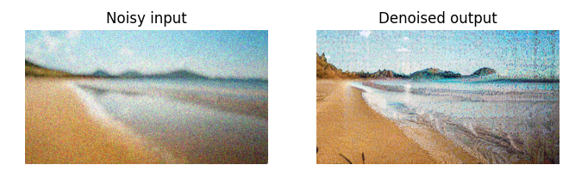
Denoising: Remove Noise, Preserve Quality
Model: Stable Diffusion v1-5 (img2img)
Parameters:
• Prompt: "clean detailed realistic photo, no noise"
• Strength: 0.4 (moderate input influence)
• Guidance Scale: 7.5
• Steps: 30
How it works:
1. Takes noisy image as input
2. Iteratively denoises using diffusion
process
3. Guided by semantic prompt
4. Outputs clean, sharp image
Why Generative?
→ Understands what "clean leaf" should look like
→ Not pixel-accurate, but semantically plausible

Slide 6
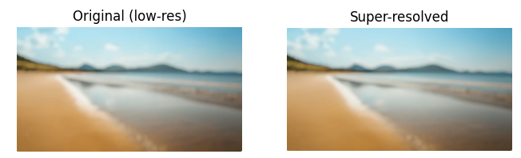
Super-Resolution: 4× Upscaling
Model: ESRGAN (Enhanced Super-Resolution GAN)
Process:
Input: 64×64 → Output: 256×256 (4× upscale)
How it works:
1. Receives low-resolution image
2. GAN synthesizes high-frequency
details
3. Adds realistic textures and edges
4. Maintains semantic content
Benefits:
✓ Sharp, detailed output
✓ Hallucination of realistic features
✓ Better than bicubic interpolation
✓ Fast inference

Slide 7
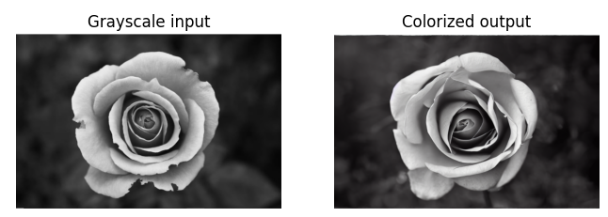
Colorization: Add Color to Grayscale
Model: Stable Diffusion v1-5 (img2img)
Parameters:
• Prompt: "vibrant realistic color photograph"
• Strength: 0.65 (creative freedom)
• Guidance Scale: 8.0
• Steps: 40
How it works:
1. Convert image to grayscale RGB
2. Condition diffusion on "color photo"
prompt
3. Synthesize plausible colors
4. Output colorized image
Results:
→ Natural green tones for leaves
→ Consistent color coherence
→ Occasional color bleeding on edges

Slide 8

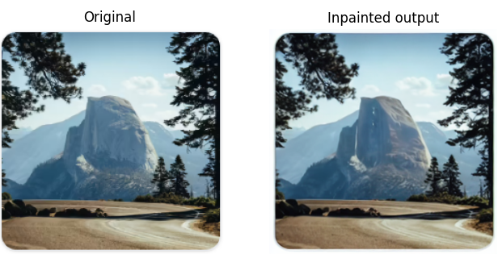
Mask
Inpainting: Fill Missing Regions
Model: Stable Diffusion Inpainting
Input:
• RGB image + Binary mask
(white = fill, black = preserve)
Parameters:
• Prompt: "restore damaged
photo, realistic, high quality"
• Strength: 0.75
• Guidance Scale: 7.5
• Steps: 40
How it works:
1. Accepts image + mask
2. Fills masked regions conditioned on context
3. Seamless blending with surrounding area
4. Outputs restored image

Slide 9
Integration: Single Python Function
run_task_on_uploaded_image(task, use_mask=False)
User Flow:
1. Upload image (Colab file UI)
2. Select task (dropdown menu)
3. For inpainting, upload mask (optional)
4. Click "Run Enhancement"
5. View before/after comparison
Advantages:
✓ One entry point for all tasks
✓ Modular, extensible design
✓ Easy to test & debug

Slide 10
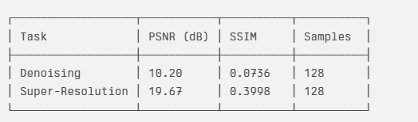
Experimental Setup And Results
Dataset: Beans (Hugging Face)
• 128 validation images
• Leaf photographs (3 classes)
• Synthetic degradation
Metrics:
• PSNR (Peak Signal-to-Noise Ratio)
Higher is better: >25 dB = excellent
• SSIM (Structural Similarity Index)
Range [-1, 1]: >0.8 = very good
Synthetic Degradation:
• Noisy images: Gaussian noise σ = 25.0
• Low-res images: 4× downsampling
Interpretation:
• Denoising: Low PSNR (generative, not pixel-exact)
• Super-Res: Moderate PSNR (hallucination + upscaling)
• Both: Visually coherent & useful outputs

Slide 11
Known Issues
1. Safety Checker
→ Flags benign content, returns black images
→ Disabled for research use
2. Prompt Sensitivity
→ Output quality depends on text prompts
→ Suboptimal prompts → poor results
3. Computational Cost
→ 30-40 seconds per image (GPU required)
→ Not real-time suitable without optimization
4. Semantic Hallucination
→ Models may add objects not in original
→ Artifacts in ambiguous inpainting scenarios

Slide 12
KEY INSIGHTS
Generative vs. Pixel-Exact Restoration
Traditional Approach: Generative Approach:
• Wiener filtering • Diffusion models
• Total variation • GANs (ESRGAN)
• Optimize PSNR/SSIM • Optimize perceptual quality
• Pixel-level fidelity • Semantic coherence
Implication:
Don't judge generative models by PSNR alone
✓ Perceptual metrics (LPIPS, FID) better suited
✓ User studies capture real-world satisfaction

Slide 13
Key Takeaways
✓ Integrated restoration system (4 tasks)
✓ Leverages pretrained Hugging Face models
✓ No training from scratch required
✓ Practical outputs despite modest PSNR
Paradigm Shift:
From classical signal processing
→ To learned generative approaches
→ Prioritizing perceptual quality & semantics
Impact:
• Democratizes image restoration (easy to use)
• Powerful pre-trained models available
• Extensible for deployment
Next Steps:
• Fine-tune on domain-specific data
• Perceptual evaluation & user studies
• Deployment optimization & scaling

Slide 14
Contribution
Name | Contribution
Nitish Bhardwaj | Problem Identification, End to end Generative process building including end to end Model pipeline building, Report building and Presentation building
Syed Ahmed Ali | Problem Identification, End to end Generative process building including end to end Model pipeline building, Report building and Presentation building

